Slide 1
Lambda

Slide 2
Why was lambda named as it is?
In mathematics , lambda in calculus are self contained functions that can be used as bricks for large problems.
Just like that in AWS lambda is a serverless service in which it automatically runs code without managing servers as well as scales up and down as per the requirements of the user

Slide 3
Purpose of lambda ?
As we know that lambda is a serverless service in AWS.
The main purpose of lambda is to reduce the overhead and the cost of maintaining the infrastructure (servers).
It is a service made with considering the cost of server maintenance , OS maintenance , and capacity maintenance.

Slide 4
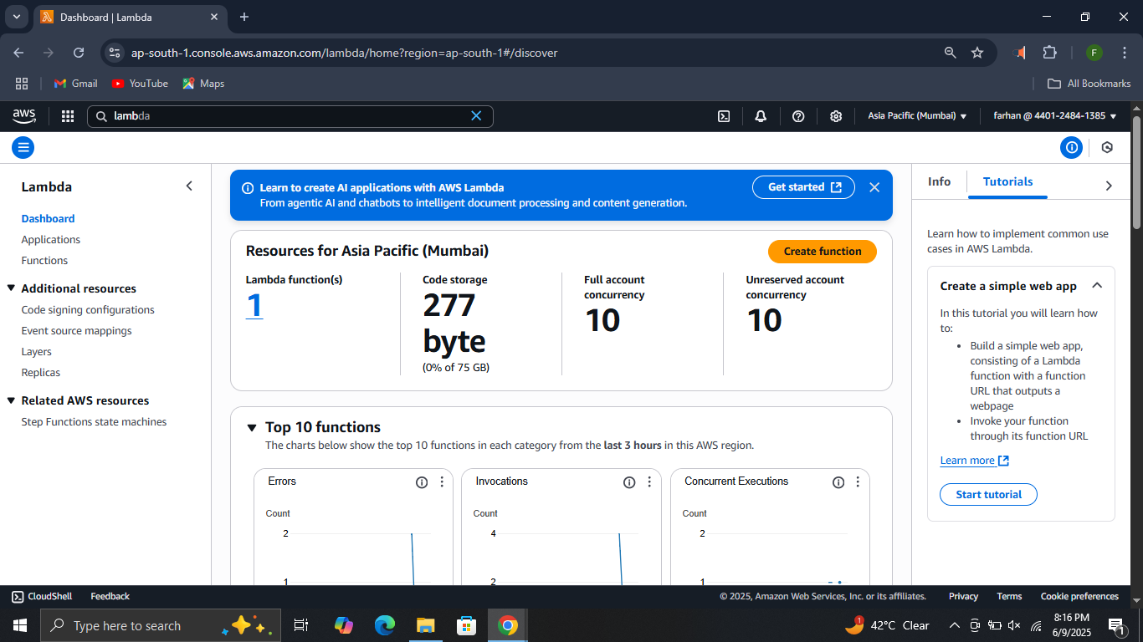
How to use lambda?
Step 1. Log in to your IAM account. Make sure you have administrator access. Click on functions in lambda console

Slide 5
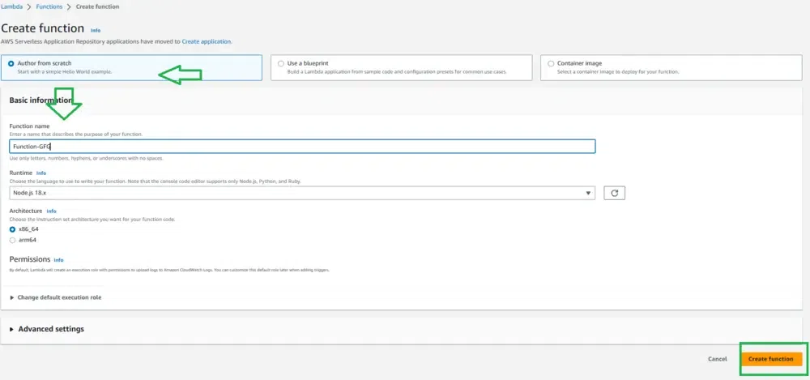
Step 2. Click on create function and do changes as shown below.

Slide 6
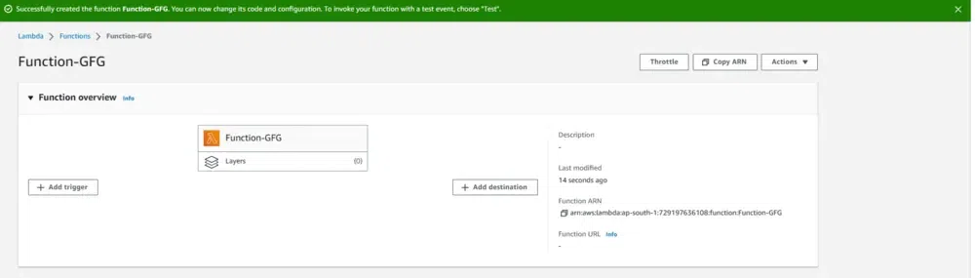
Step 3. Successfully your lambda function is created.

Slide 7
Step 4. To change the code source scroll down to code source. Click on index.mjs and replace the given code with the existing one. Click on deploy.
export const handler = async (event, context) => {
const length = event.length;
const width = event.width;
let area = calculateArea(length, width);
console.log(`The area is ${area}`);
console.log('CloudWatch log group: ', context.logGroupName);
let data = {
"area": area,
};
return JSON.stringify(data);
function calculateArea(length, width) {
return length * width;
}
};

Slide 8
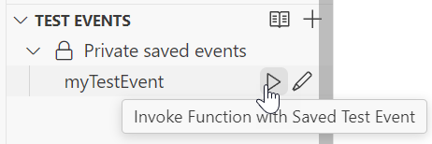
Step 5. Create new test event and replace the JSON with the code. Click save.
{
"length": 6,
"width": 7
}
Step 6. To test , click on the run icon next to your test event

Slide 9
Your output after testing should look like this.
Status: Succeeded
Test Event Name: myTestEvent
Response
"{\"area\":42}"
Function Logs
START RequestId: 5c012b0a-18f7-4805-b2f6-40912935034a Version: $LATEST
2024-08-31T23:39:45.313Z 5c012b0a-18f7-4805-b2f6-40912935034a INFO The area is 42
2024-08-31T23:39:45.331Z 5c012b0a-18f7-4805-b2f6-40912935034a INFO CloudWatch log group: /aws/lambda/myLambdaFunction
END RequestId: 5c012b0a-18f7-4805-b2f6-40912935034a
REPORT RequestId: 5c012b0a-18f7-4805-b2f6-40912935034a Duration: 20.67 ms Billed Duration: 21 ms Memory Size: 128 MB Max Memory Used: 66 MB Init Duration: 163.87 ms
Request ID
5c012b0a-18f7-4805-b2f6-40912935034a

